Slide 1
Patient Survival Prediction
DTSA 5509: Introduction to Supervised Learning

Slide 2
Agenda
Introduction - Problem Statement
Overview of Dataset & EDA
Data Distribution, Outliers, and Missing Data
Model Setup
Results!
Conclusion - Lessons Learned

Slide 3
Problem Statement
The primary goal of this project is to develop and validate a prediction model for all-cause in-hospital mortality among admitted patients.
This model aims to enhance the predictive capabilities of healthcare systems enabling better patient management and allocation of resources.
In-hospital mortality is a critical metric that hospitals use to gauge the quality of care.
Despite its importance, the predictors of mortality among admitted patients remain poorly characterized. This project seeks to address this gap by leveraging machine learning techniques to predict the likelihood of in-hospital death based on a range of clinical and demographic factors.

Slide 4
Dataset Overview
Dataset Overview:
Title: "Patient Survival Prediction" by Mitisha Agarwal, hosted on Kaggle.
Size: 31.41MB with 91,713 patient records and 85 distinct features.
Data Composition:
Includes clinical and demographic data from hospital patients aimed at analyzing in-hospital mortality.
Features range from continuous numeric (e.g., age, BMI, vital signs) to categorical (e.g., gender, ethnicity, type of ICU).
Critical Variables:
Key metrics such as APACHE scores and maximum/minimum physiological readings from the first day and hour of ICU admission.
Outcome variable: hospital_death (0 or 1 indicating mortality).
Data Quality and Utility:
Inclusion of various health status indicators (e.g., presence of comorbidities, elective surgery status).
Contains an "Unnamed: 83" column suggesting a potential data extraction issue noted for review or deletion.
Notes:
APACHE codes are part of the APACHE (Acute Physiology And Chronic Health Evaluation) scoring system, a classification system that is widely used in intensive care medicine to assess the severity of illness and predict outcomes in critically ill patients. Here’s a bit more about the system and its components:

Slide 5
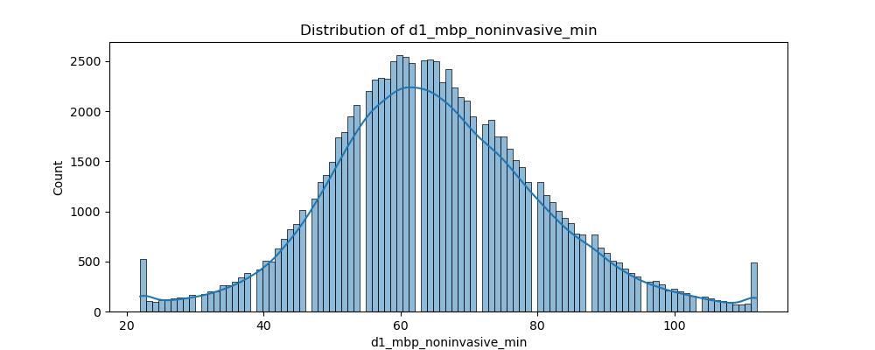
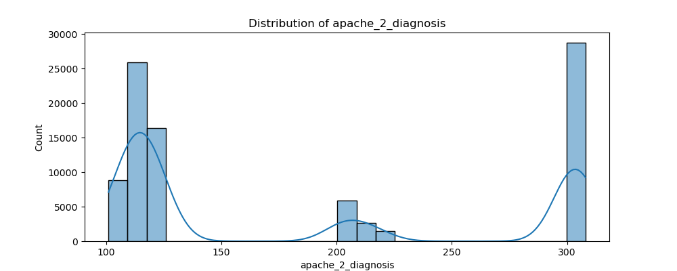
Data Distributions
Skewness and Kurtosis Analysis:
Skewness tests for asymmetry in data distribution, while kurtosis assesses the heaviness of tails. These metrics help determine the data's deviation from normality.
Impact on Modeling Choices:
Due to non-normal distribution of key variables, modeling strategies were chosen that do not assume normality, optimizing the analysis for real-world data behavior.

Slide 6
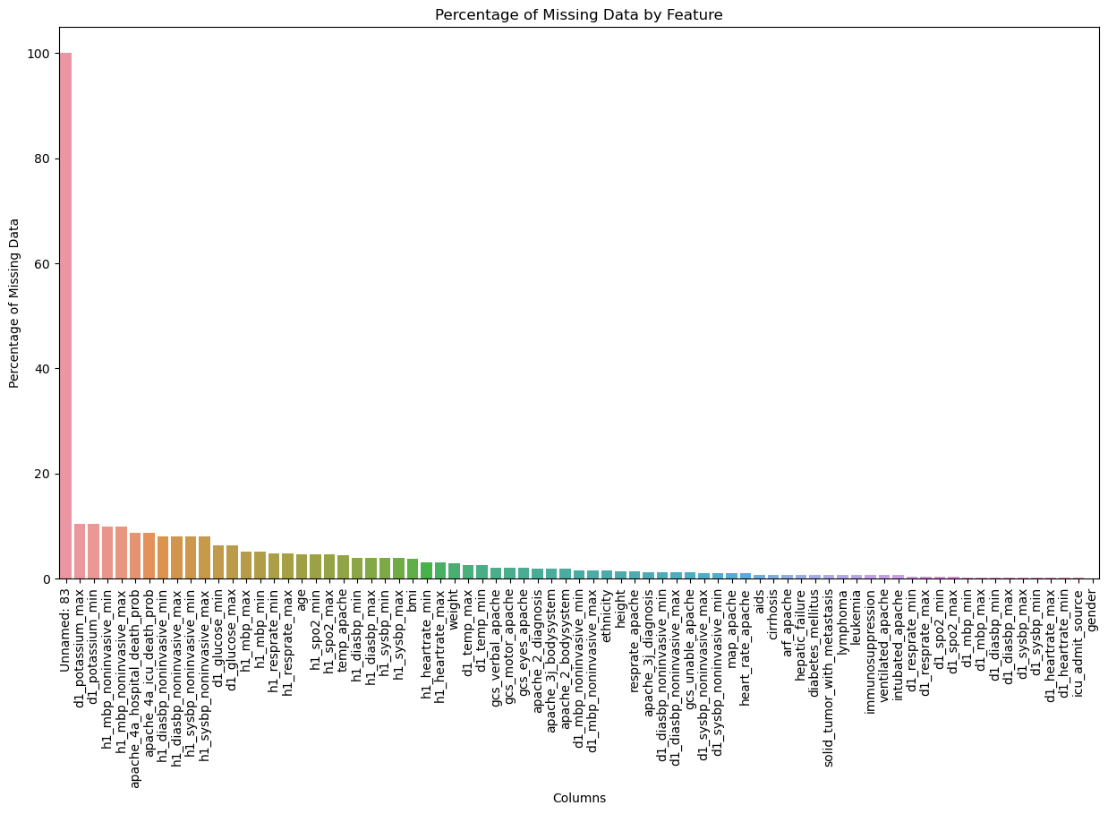
Missing Data
Significant missing values noted, with the "Unnamed: 83" column entirely missing (subsequently deleted). Other essential variables like 'apache_4a_hospital_death_prob' and 'd1_glucose_max' show missing data ranging from 6.3% to 10.5%, likely due to varying circumstances at the time of ICU admission.
Missing data analyzed for patterns: MCAR (Missing Completely at Random), MAR (Missing at Random), and MNAR (Missing Not at Random). Key features like 'elective_surgery' and 'icu_type' identified as likely MCAR; others such as 'age' and 'bmi' categorized as potentially MAR or MNAR, indicating more complex reasons behind their absence.
Missing data types impact modeling strategies: straightforward imputation for MCAR, nuanced methods needed for MAR, and complex approaches for MNAR to avoid biases and maintain the integrity of the dataset.
Employed median values for imputing numerical features and mode for categorical features to preserve central tendency and minimize distribution disruption.

Slide 7
Outliers
Outlier Detection Strategy:
Utilized z-score analysis with a threshold of 2.5 to identify outlier data points defining outliers as those significantly deviating from the mean in terms of standard deviation units.
Flexibility and Adjustment:
The method allows for adjustments in the sensitivity of outlier detection providing a robust tool for preprocessing and ensuring data quality by addressing extreme variations.
Impact on Dataset:
This approach led to the removal of 1,273 observations categorized as outliers refining the dataset for more representative and unbiased statistical analysis.

Slide 8
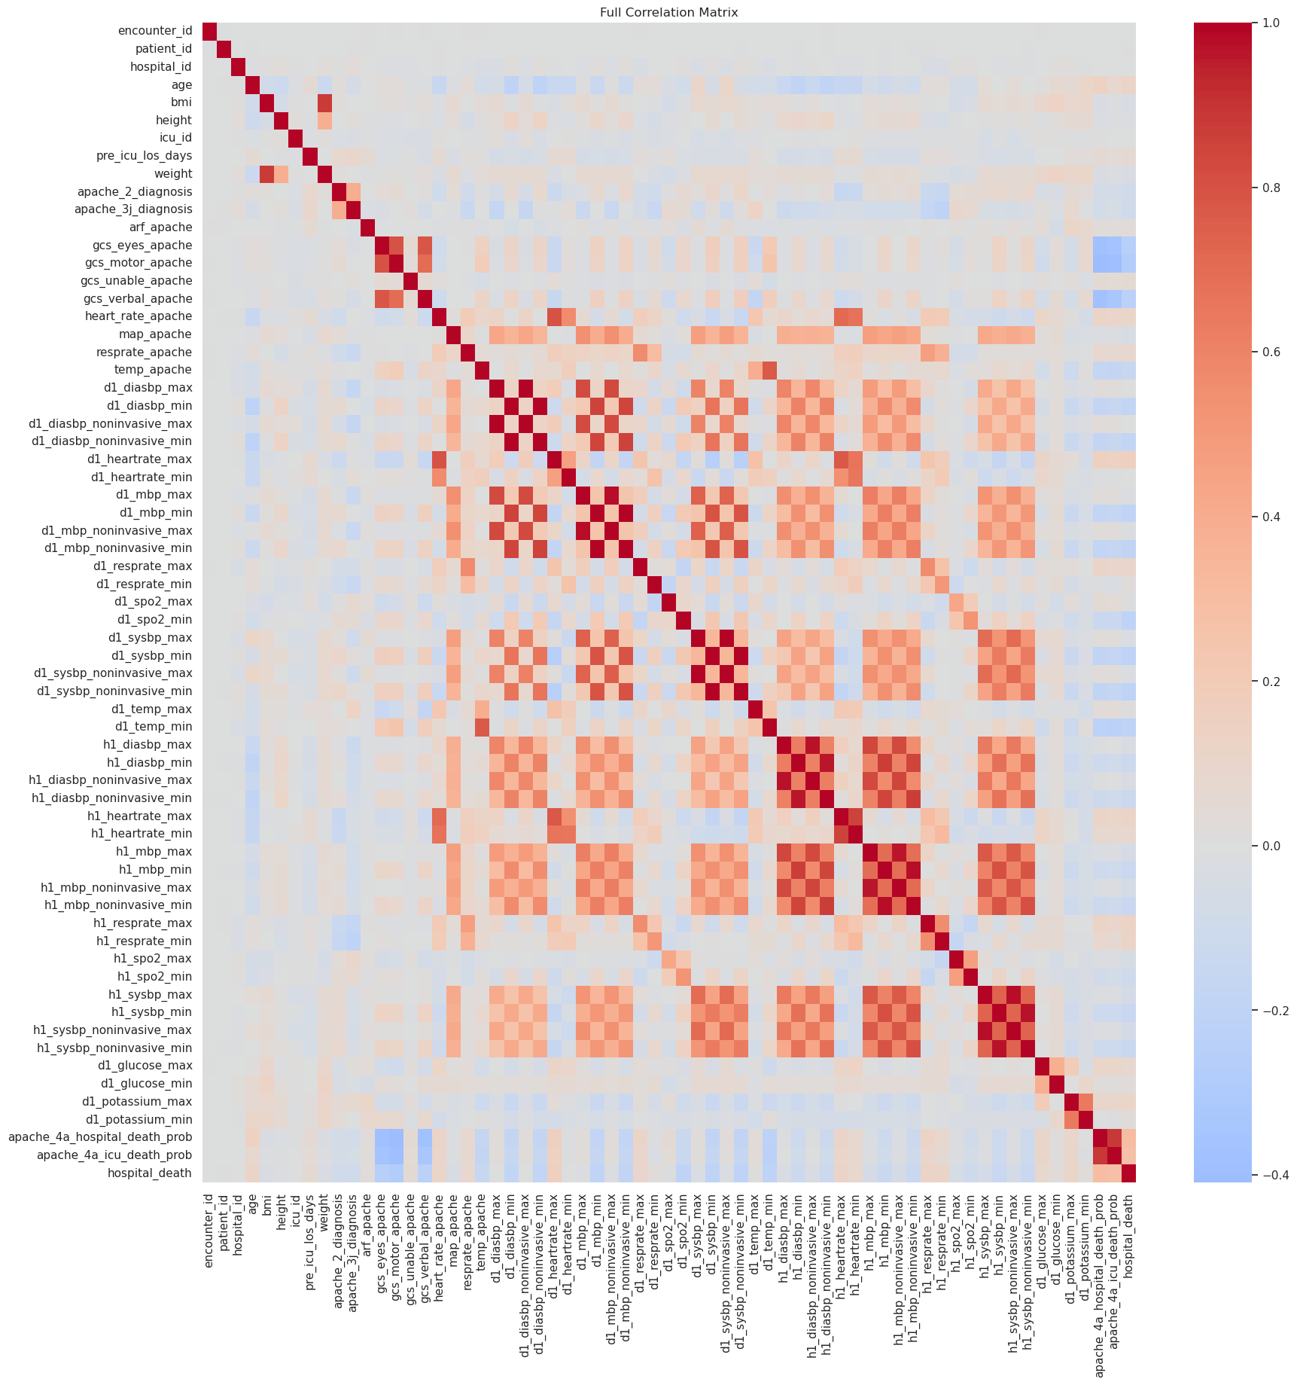
Data Correlation Matrix
Significant Correlations and Redundancies:
Detected strong correlations (>0.8) among variables such as weight and BMI, components of the Glasgow Coma Scale, and invasive vs. non-invasive blood pressure readings, indicating dependencies that could impact model performance due to multicollinearity and overfitting.
Implications for Modeling and Data Reduction:
High correlations among similar measurements and predictive metrics like apache_4a_icu_death_prob and apache_4a_hospital_death_prob suggest redundancy; removing one from each correlated pair can streamline models and enhance efficiency without losing essential information.
Data Reduction
44 variables found to be highly correlated - 22 removed!

Slide 9
Model Training
Preparation and Preprocessing:
After preprocessing to standardize numerical features and one-hot encode categorical variables, dimensionality was reduced using UMAP to focus on the most informative features enhancing model training efficiency.
Model Training and Optimization:
Trained a variety of models including logistic regression, random forest, SVM, XGBoost, and a neural network, optimizing hyperparameters via GridSearchCV to evaluate model effectiveness based on cross-validation accuracy.
Experimental Approaches:
Conducted two experiments: the first without dimensionality reduction or addressing class imbalance, and the second incorporating both strategies to compare impacts on model performance and generalizability.

Slide 10
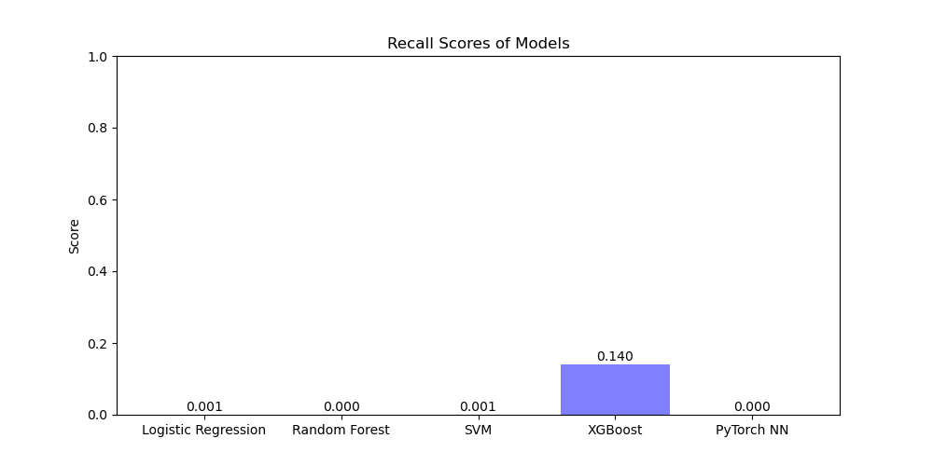
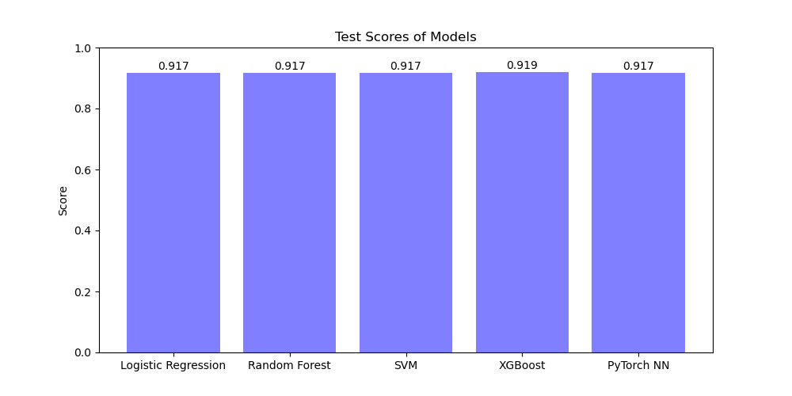
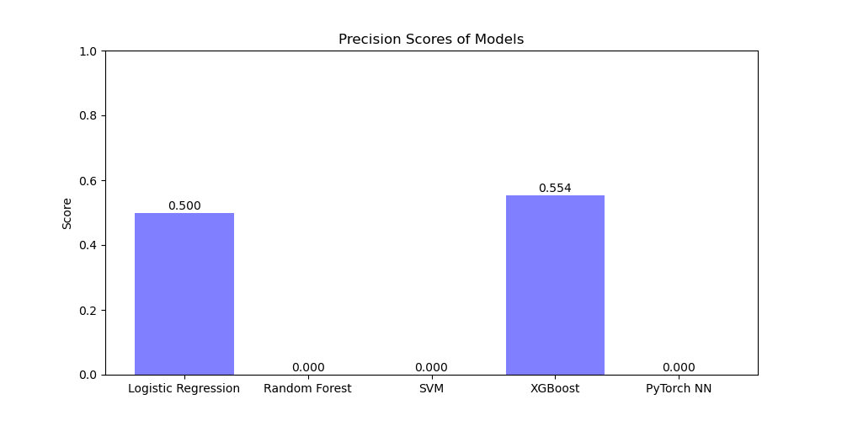
Results - Experiment 1

Slide 11
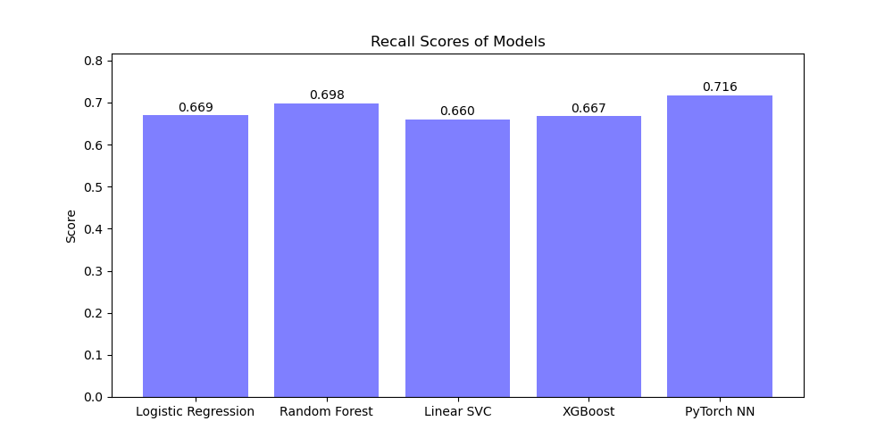
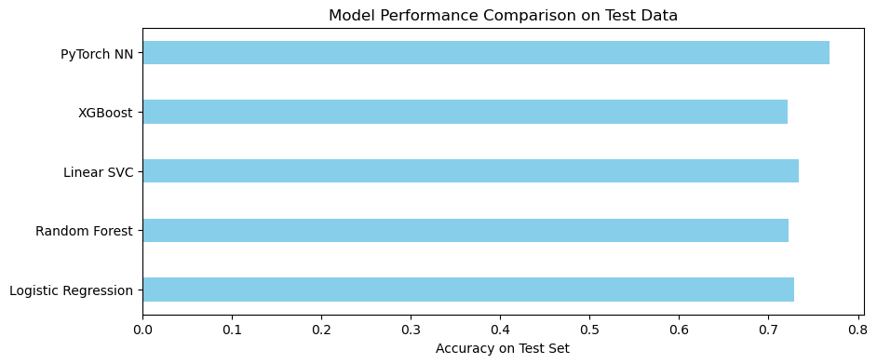
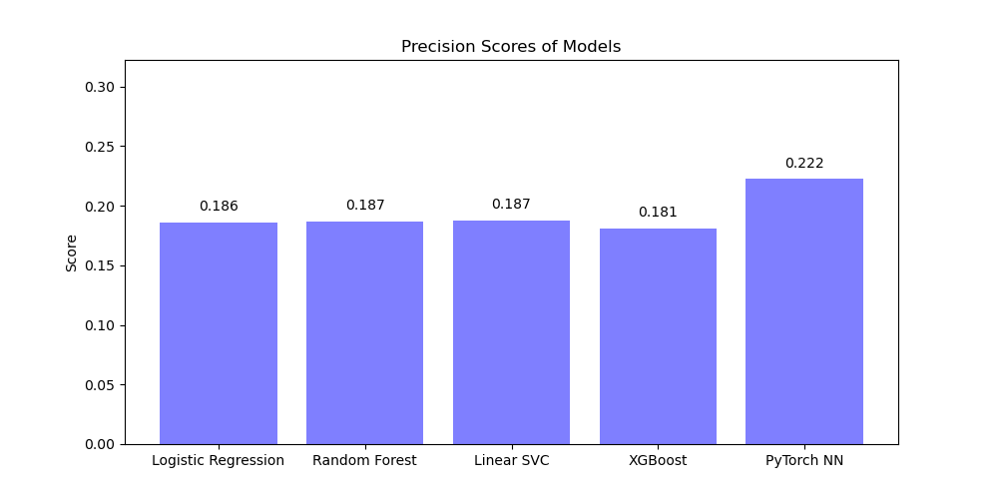
Results - Experiment 2

Slide 12
Results - Experiment 2
Implementation of SMOTE for Class Balance:
Applied SMOTE to address significant class imbalance, enhancing the training dataset by generating synthetic samples from the minority class resulting in improved model generalization but lower overall test set accuracy.
Model Performance with Adjusted Dataset:
PyTorch NN emerged as the best performing model with a test score of approximately 77%, showing a substantial improvement in precision and recall metrics, indicating its effectiveness in balancing the detection of positive instances with the occurrence of false positives.
Considerations for Clinical Deployment:
Despite enhancements in model performance through SMOTE, precision and recall values remain insufficient for real-world clinical application underscoring the need for further model optimization to reduce the risks associated with false positives and negatives in a hospital setting.

Slide 13
Conclusion - Lessons Learned
Conclusion of Experiments:
Despite employing strategies like GridSearch, dimensionality reduction, and SMOTE for class imbalance, the models did not reach the performance standards necessary for production in a clinical setting. However, deep neural networks showed potential due to their capacity to model complex relationships.
Lessons Learned:
GridSearch proved to be computationally intensive, suggesting the use of RandomGrid search and GPU-accelerated algorithms for future projects to enhance efficiency.
Different dimensionality reduction techniques such as PCA, Truncated SVD, and Random Projections should be explored, including a GridSearch over UMAP components to optimize model performance.
Next Steps for Improvement:
Explore alternative imputation strategies, including K-nearest neighbors and multiple imputations, to potentially enhance data integrity.
Experiment with various outlier detection methods like IQR and DBScan clustering to assess their impact on model performance aiming to refine detection accuracy and reliability.

Slide 14
Thank you!

